Slide 1
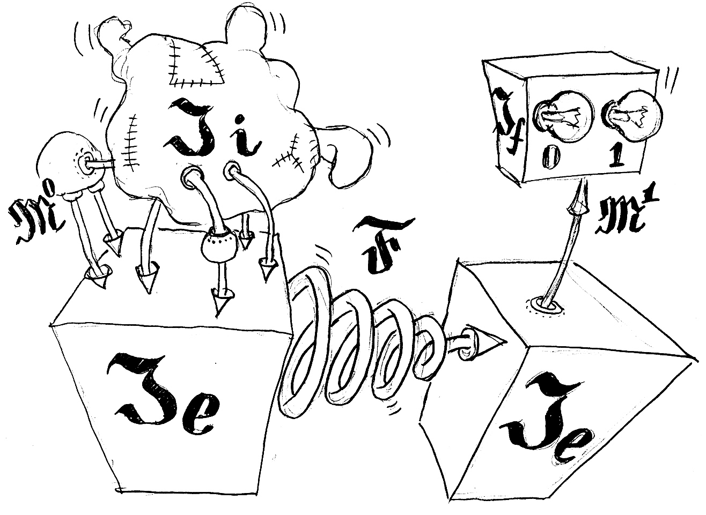
Overfitting and generalization ability of data mining models

Slide 2
Formal definitions
Items, instances . Belongs to set X
How to represent x \in X? Feature description F_i(x)
Answers. Belongs to set Y
Underlying model y*:X->Y
Training data set (x_i, y_i)
Model (hypothesis) a:X->Y
Generalization ability: how good is model on test X\{x_1, …, x_l}?

Slide 3
Data mining task tree
Classification (|Y|<inf)
Regression (|Y|=R)
Time series forecasting
Learning to Rank for Information retrieval
Clustering
Association Rules Mining

Slide 4
Loss Function
Realm | Loss Function
Classification | Misclassification errors count. Different kind of errors.
Regression, Time series prediction | Mean square error. In general much better quality function is how much money did we save to customer?
Information retrieval | nDCG, MAP, Precision@N, Click Through rate
Clustering | Mutual distance

Slide 5
Classification task
Medical diagnostics
[Классификация полезных искапаемых]
Spam detection
Off-line and on-line signature detection
Speech recognition
Credit scoring
Churn prediction

Slide 6
Regression task
Stock market and illegal behaviour detection
Electricity consumption forecasting
When to put money into MiniBANK?

Slide 7
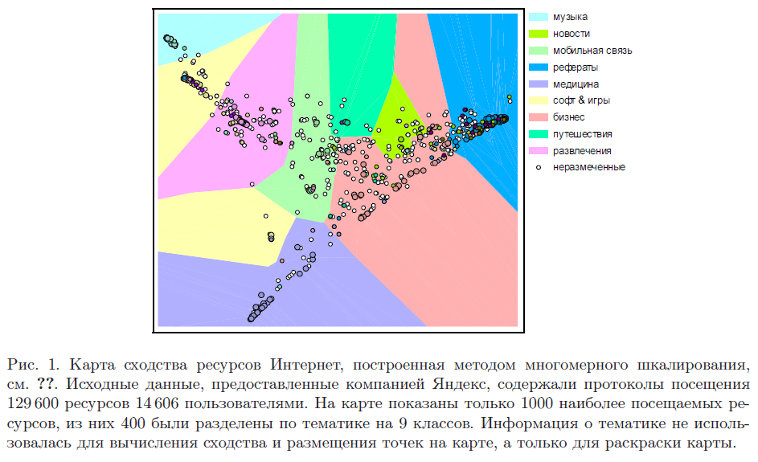
Clustering
News clustering
Users and resources similarity

Slide 8
Association rules mining
User buy X. What else could be reasonable to propose him?
X->Y
Friday? Pampers->Beer!

Slide 9
Typical Ideas from Data Mining
Do we need this chapter? ☺

Slide 10
How it affects search?
ToDo: find out how is used in Yahoo and Yandex.
Query categorization (what was user really searching for? Document? Information?)
User clustering? (results relevant for some users could be irrelevant for others)
Duplicate detection?
Information extraction from document, document markup

Slide 11
